Slide 1

Application Insights

Slide 2
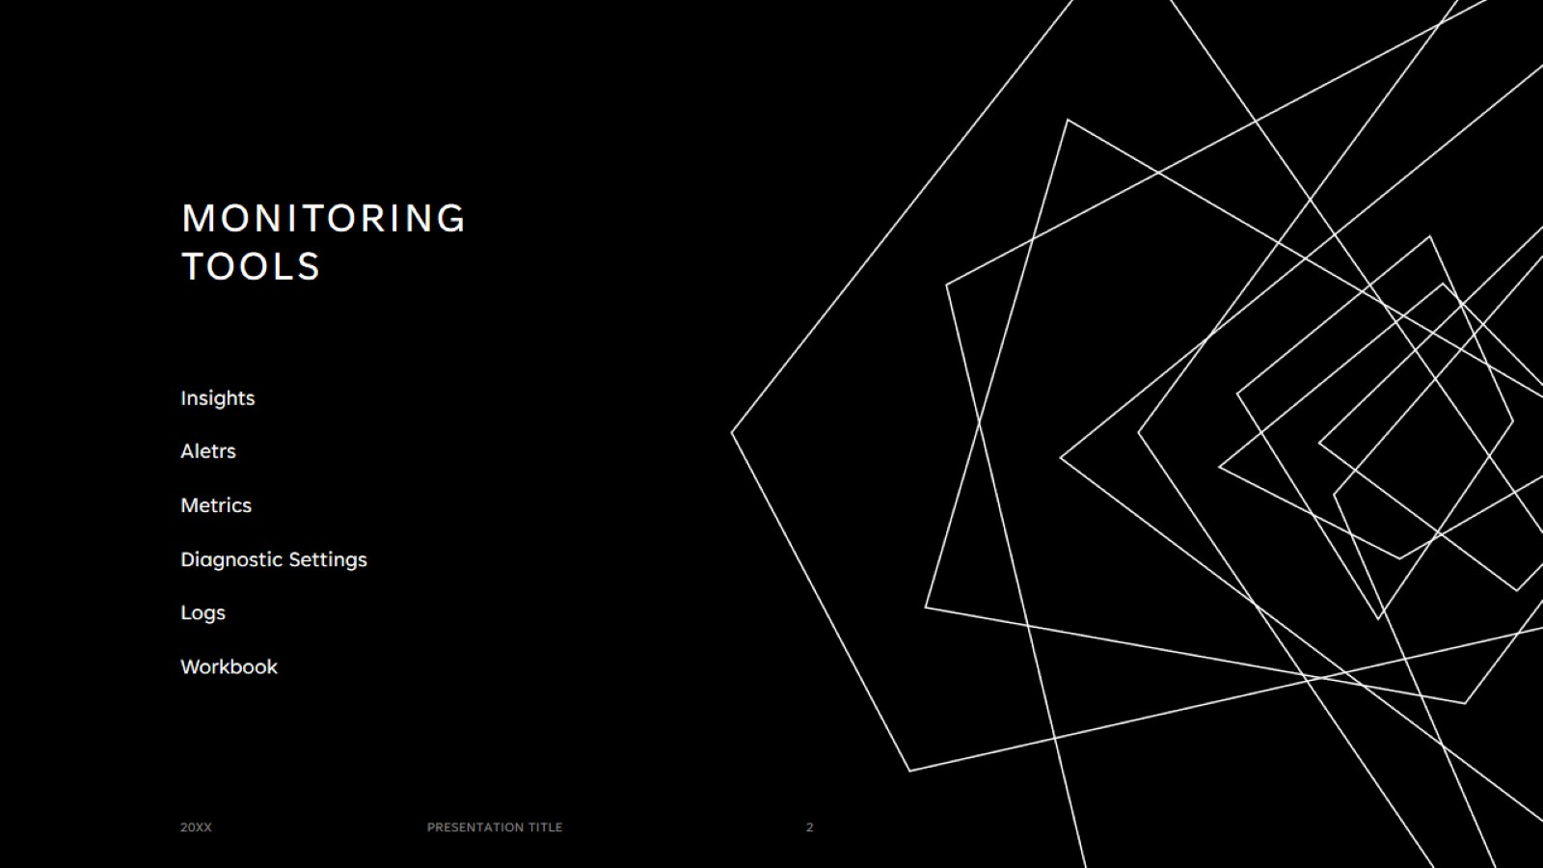
Monitoring tools

Slide 3
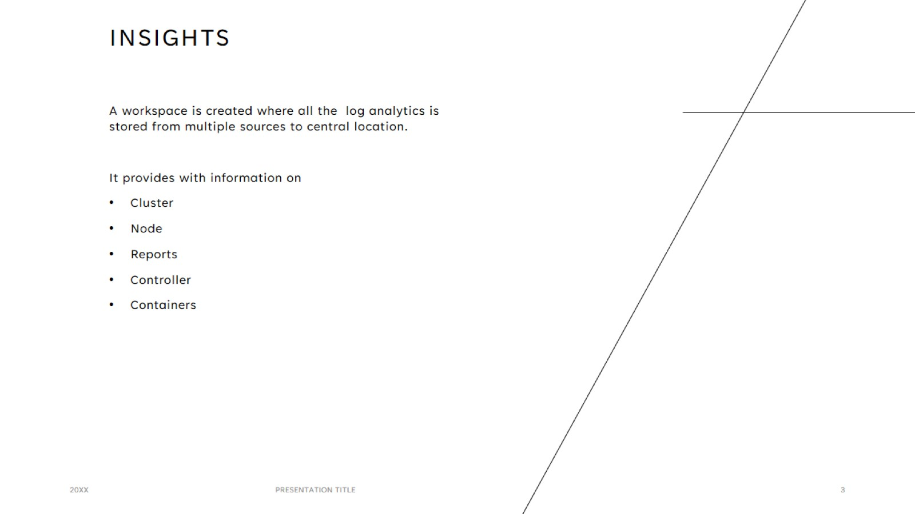
Insights

Slide 4
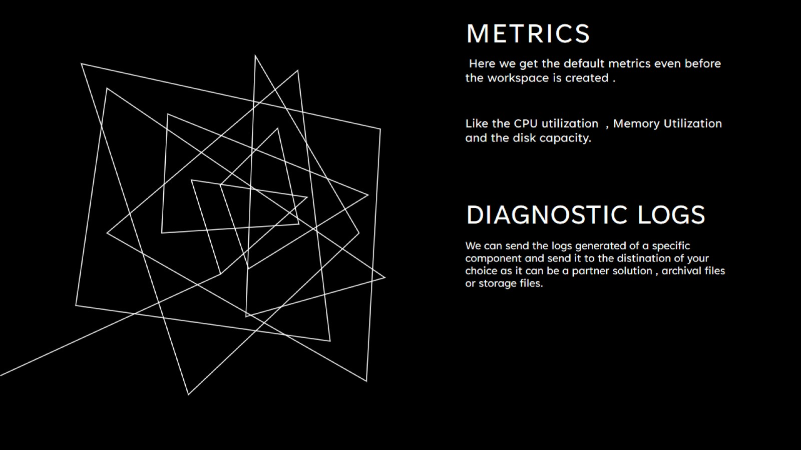
Metrics

Slide 5
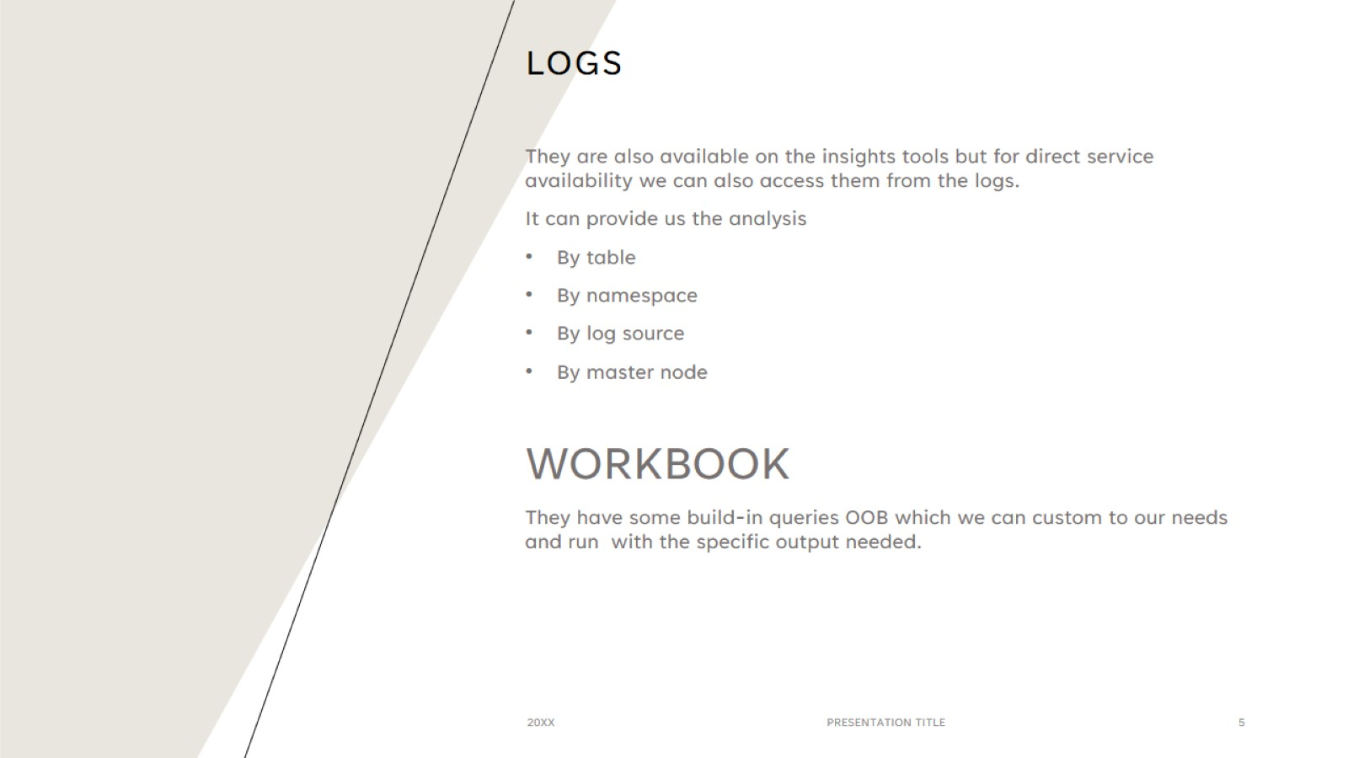
LOGS

Slide 6
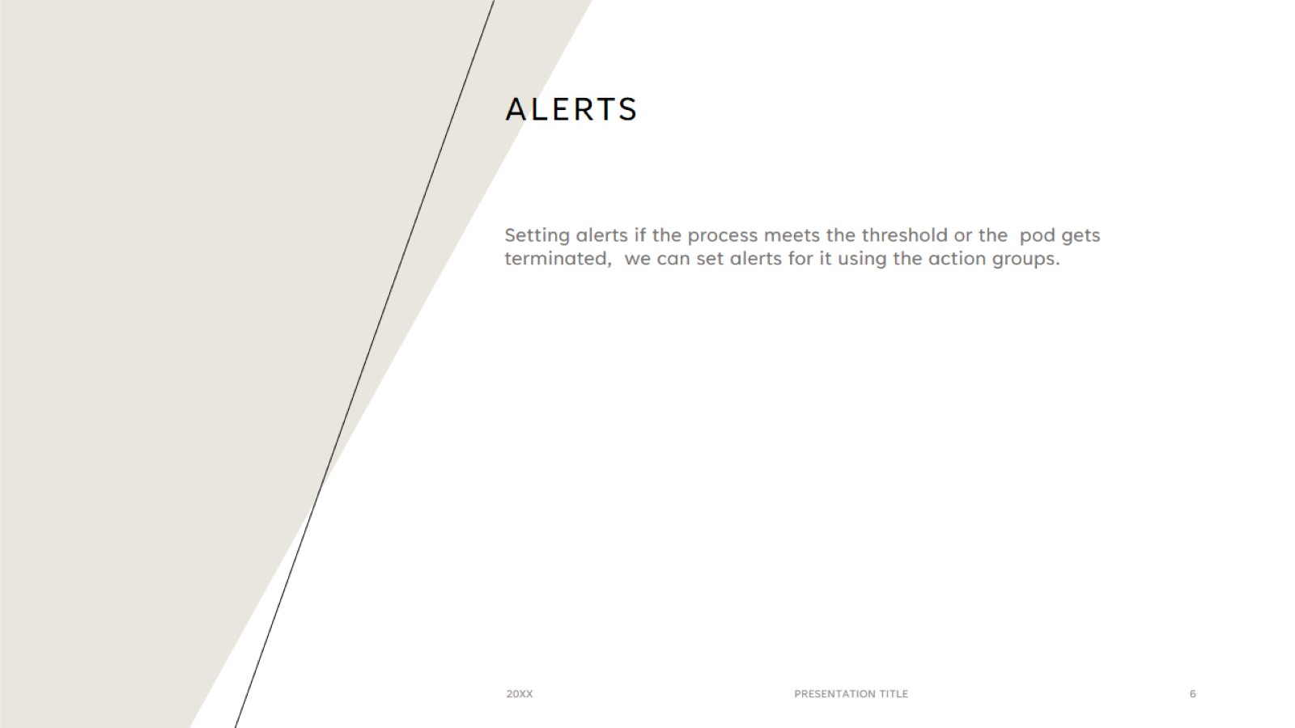
Alerts

Slide 7


